Slide 1
POETRY – II 20UEN4CC7
Dr. R. SOFIYA
Assistant Professor of English
Jamal Mohamed College(A)
Trichy- 20

Slide 2
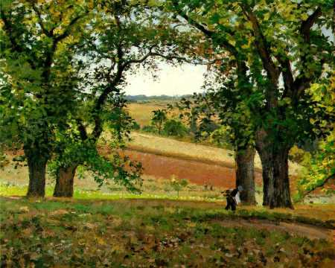
PIED BEAUTY
BY
GERARD MANLEY HOPKINS

Slide 3
ABOUT THE AUTHOR
Gerard Manley Hopkins was born on 28 July 1844 in Startford,Essex,England.
He was an English poet and Jesuit priest,whose posthumous fame established him among the leading Victorian poets.
Hopkins won the poetry prize at the Highgate Grammar School and in 1863 was awarded a grand to study at Balliol College,Oxford.
His work was not published in collected form until 1918,but it influenced many leading 20th-century poets.
Died June 8,1889

Slide 4
ABOUT THE POEM
Pied Beauty was written in sprung rhythm and it is curtal sonnet.
It is a kind of hymn of praise to God that wonders at the varied world that God created.
The poem rejoices the unique beauty crafted by God.
It was written in 1877 and first published in 1918 in poems of Gerard Manley Hopkins.
The poem acknowledges God’s astonishing creation in this universe and also shows the diversity of things in the universe created by God.
As an act of prayers,he thanks God and gives a list of things he has created for Mankind.

Slide 5
POEM ANALYSIS
‘Pied’ means having two or more colors,and it is this quality of variety that the speaker most admires about God’s work.
The first stanza is taken up with giving examples of particular kind of beauty,which essentially describe things that have a pattern of two or more colors these “things” show variety or opposites like black and white.
The first stanza,which opens with a prayer to God that praises “dappled things”.These “dappled things"are the instances of “Pied Beauty" to which the title refers.
He includes the mottled white and blue colors of the sky,the “brinded“ hide of a cow and the patches of contrasting color on a trout.

Slide 6
The speaker lists some of these more visual examples of “Piedness“;skies of two colors, the spotty pattern on fish, the contrast of chestnuts with their green coating, the coloring on birds wings. All of these parts are of God’s design and it deserves the attention to praise. The poet turns his attention to the river and landscape. These references includes man’s intervention. Where it is narrowed and made into plots. The poem is not only about the natural world that shows God’s glory but it also describes human activity. The poem begins with “glary“ and ends with “praise” this Pied Beauty is a poem that attempts to turn the reader’s attention to the beauty of the world.

Slide 7
THEME
Hopkins says that God is praise-worthy because he created such a mysterious and beautiful world. Hopkins seems to have an appreciation of natural diversity for it's own sake,in all things great and small it implies the theme of
“Wonder and amazement"

